Slide 1

Project SOS: The IoT Safety Net
Lumina Collective presents Project SOS, a smart IoT safety system designed to provide safety at the push of a button for elderly individuals living alone. This innovative system combines automatic hazard detection with an emergency button for rapid response.

Slide 2

Team Lumina Collective
Dedicated to enhancing safety and peace of mind through innovative IoT solutions.

Slide 3

What is Project SOS?
Project SOS is a smart IoT safety system for elderly individuals living alone, combining automatic hazard detection and an emergency button for instant manual alerts. It provides peace of mind through rapid emergency response.
1
Automatic Hazard Detection
Detects gas leaks and monitors air quality.
2
Emergency Button
Provides instant manual alerts.

Slide 4
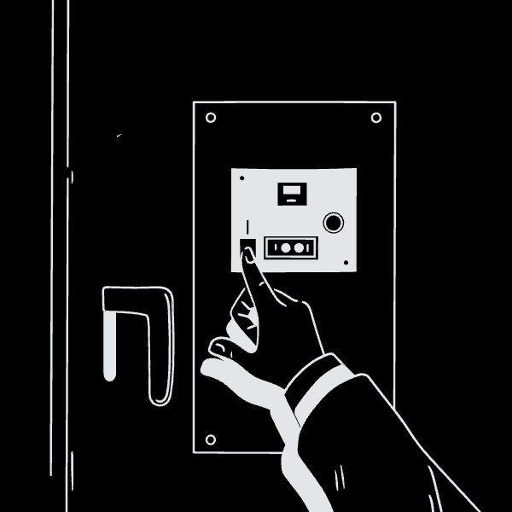
Problem Statement
Elderly individuals in smart homes, especially those living alone, face challenges such as unnoticed gas leaks/air quality hazards and the need for quick, simple alerts during physical emergencies. Project SOS addresses these critical needs.
Challenges
Gas leaks/air quality hazards may go unnoticed.
Physical emergencies require quick, simple alerts.

Slide 5

Solution Features
Automatic Detection
Emergency Button
Monitors butane, CO₂, TVOC, temperature, and humidity.
One-touch alert for immediate help.
Triggers a loud buzzer alarm for hazards.

Slide 6






Technical Components
ESP32-S3
MQ2 Gas Sensor
Brain of the system.
Butane/LPG detection.
SGP30
DHT22
eCO₂/TVOC air quality.
Humidity/Temperature.
Buzzer
Button
Alarm sound.
Emergency trigger.

Slide 7




How It Works
Project SOS ensures rapid response through two primary mechanisms:
Sensors Detect Hazards
Buzzer Sounds
ESP32 processes data.
Alerting the individual.
Or, in case of emergency:
Emergency Button Pressed
Immediate Help
Instant alarm activation.
Ensuring quick assistance.

Slide 8

Target Impact
For the Elderly
For Caregivers
Safer living environment.
Real-time hazard alerts.
Quick access to help.

